Slide 1

(Open Source) Parental Controls
CorkSec #83, 2020-05-12
Johannes Ahlmann

Slide 2
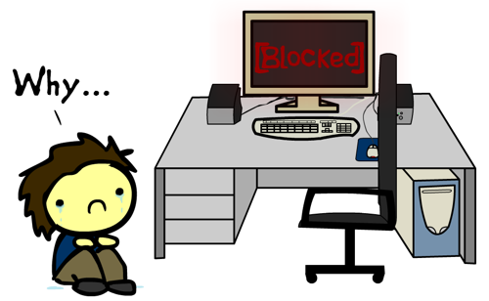
Parental Controls
AKA: "Acceptable Use Policies"
Device-level
Network-level
Content-level
Mobile Device Management (MDM)
Logging, Auditing

Slide 3
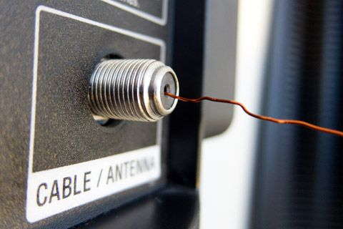
Obligatory Personal Anecdote
When I was 11 years old my mother took away the antenna cable for our television to keep me from watching too much TV.
I figured out that a simple piece of wire worked just fine in place of a coax cable.
Never underestimate the creativity and persistence of a child!

Slide 4

Preamble - "The Talk"
Communication over technical solutions
Technical solutions should only be a small part in fostering digital literacy and responsible media consumption
All technical solutions can be circumvented
All you need is one child in the circle of friends with an unrestricted device
Attackers always go after the weakest link ;)

Slide 5
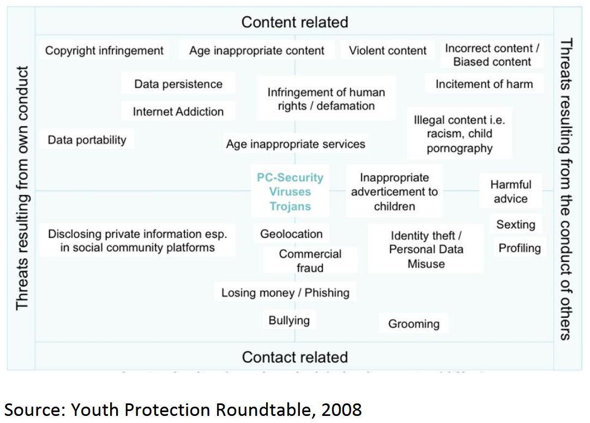
Threat Model
Unfettered access (duration, time of day, type of content)
Inappropriate content
Social media (bullying, anti-social behavior, grooming, etc.)
Uncontrolled/ intransparent access
App Store purchases
Gambling, etc.

Slide 6

Device-Level
Device Separation
very hard to enforce parental controls on shared devices
used Android devices, hand-me-downs should be relatively affordable (~75 EUR)
Parent Device Authentication
Prevent access to non-managed devices
Fingerprint, face recognition
OS features
iOS Screen Time
Android Screen Pinning
Google Parent Link
Apps
DNS-based

Slide 7
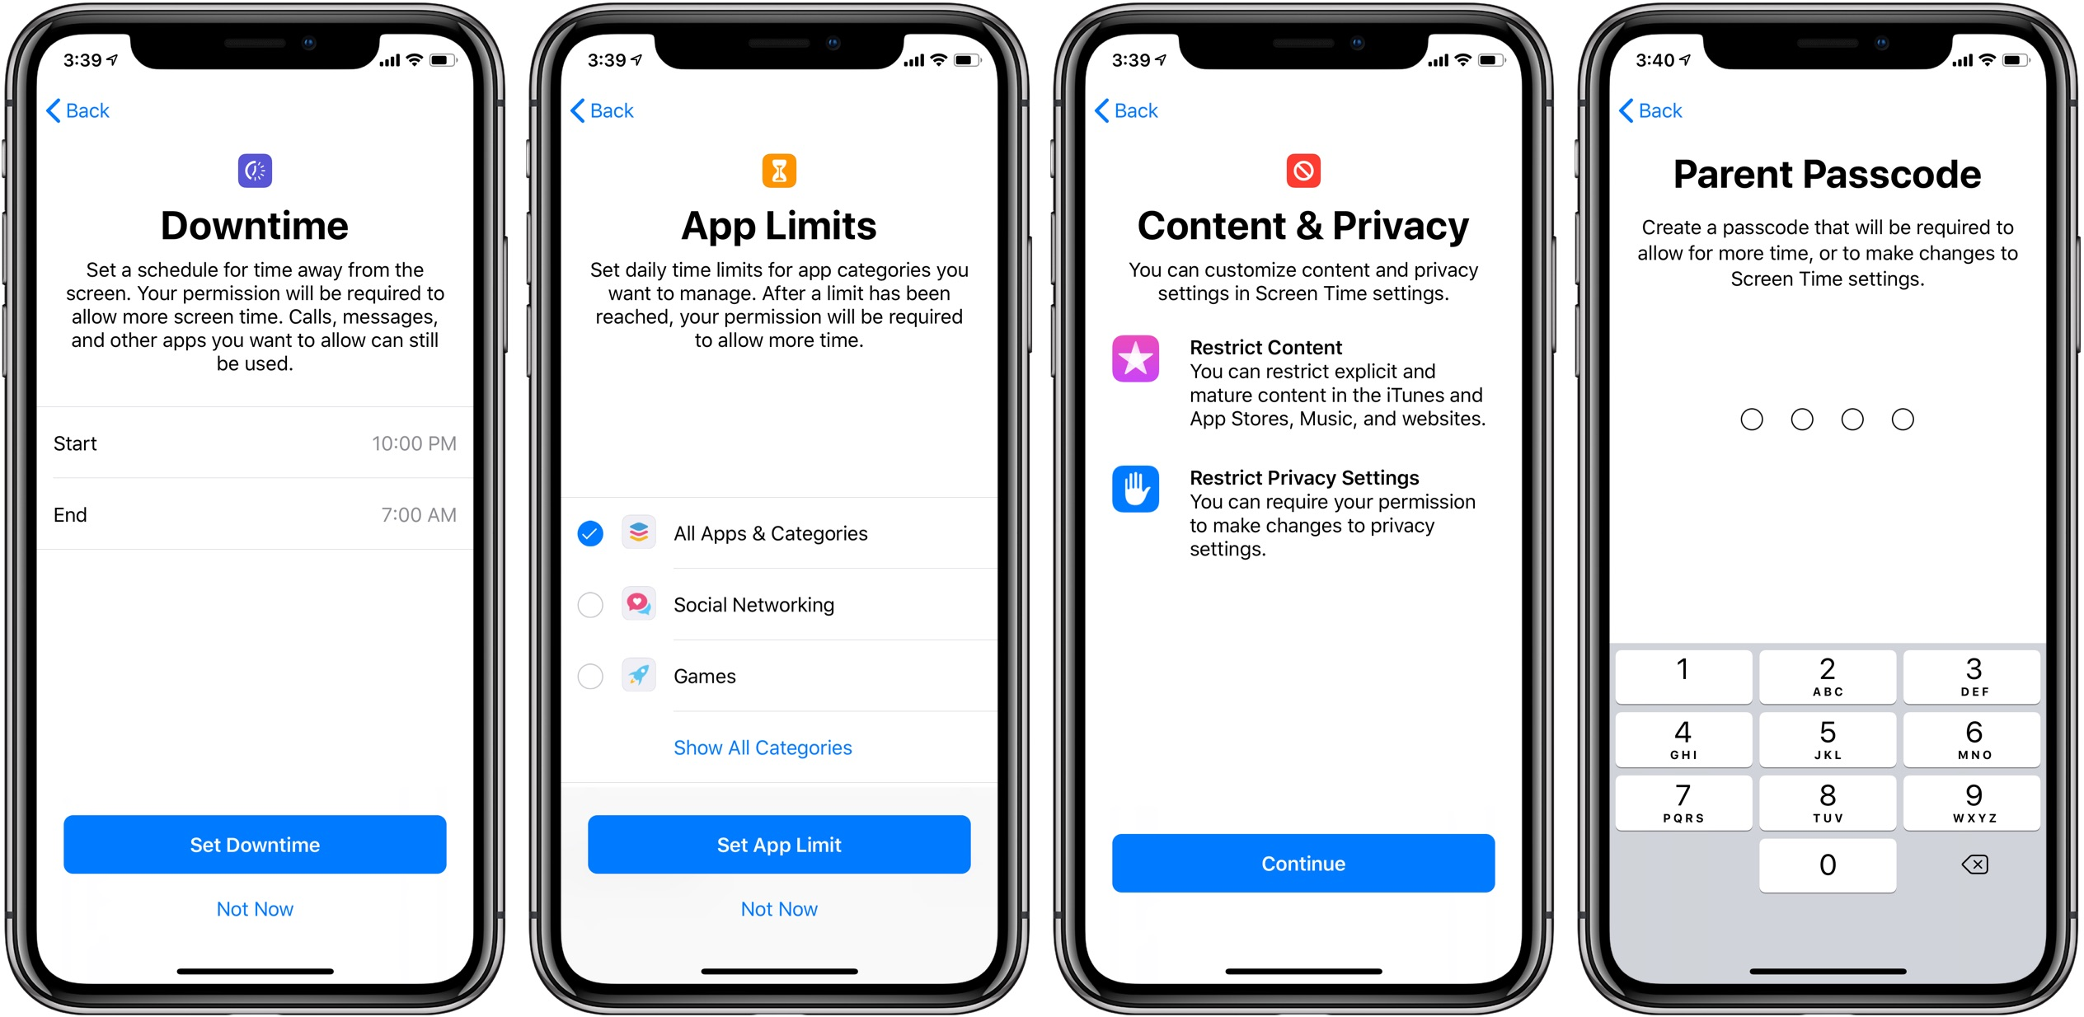
OS-Level 1/2

Slide 8
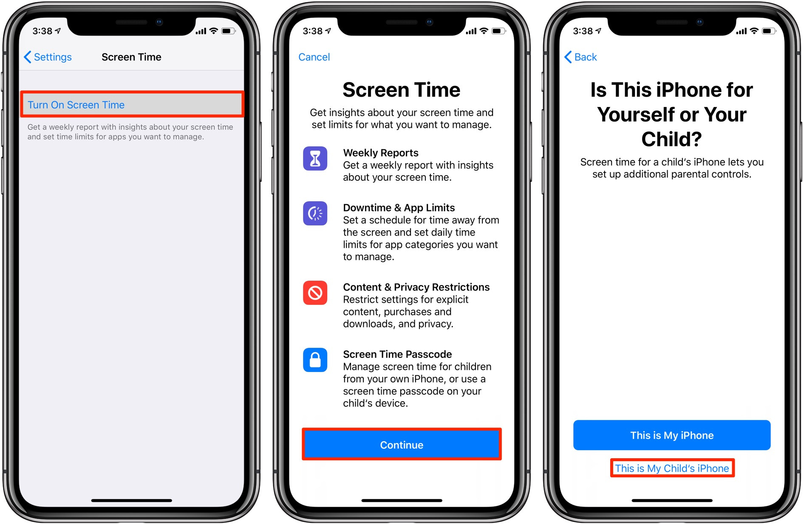
OS-Level 2/2

Slide 9
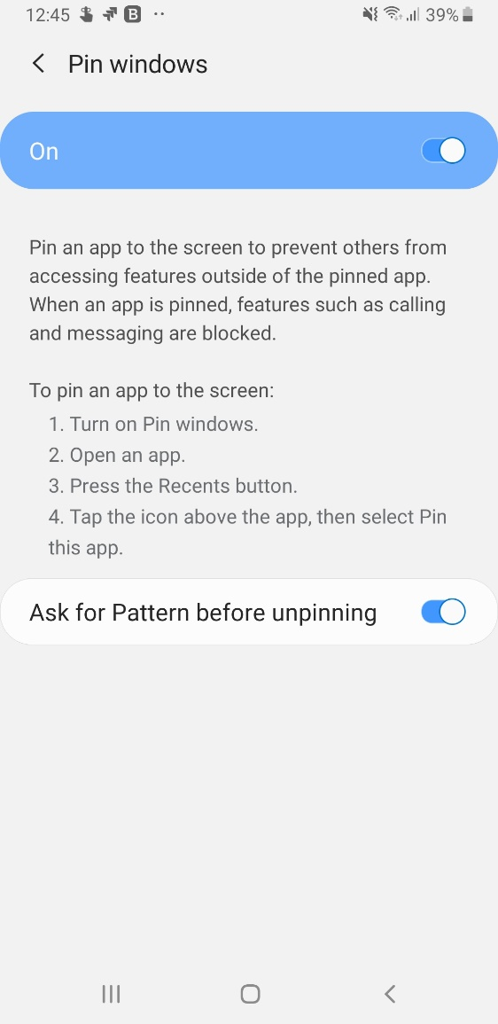
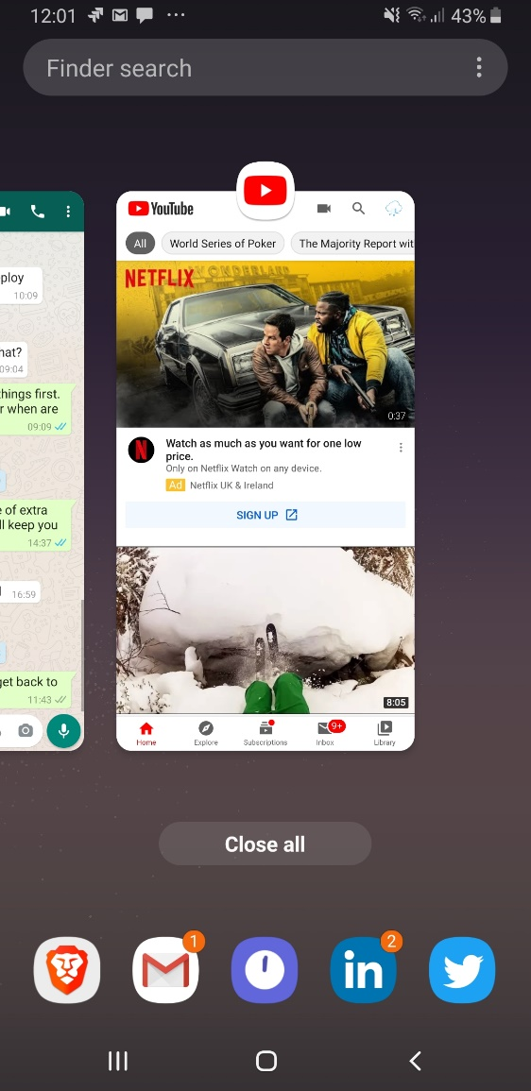
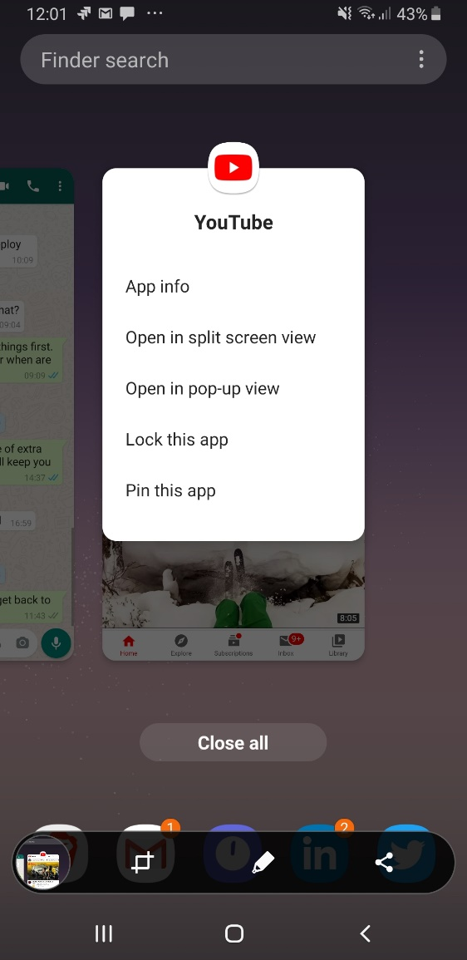
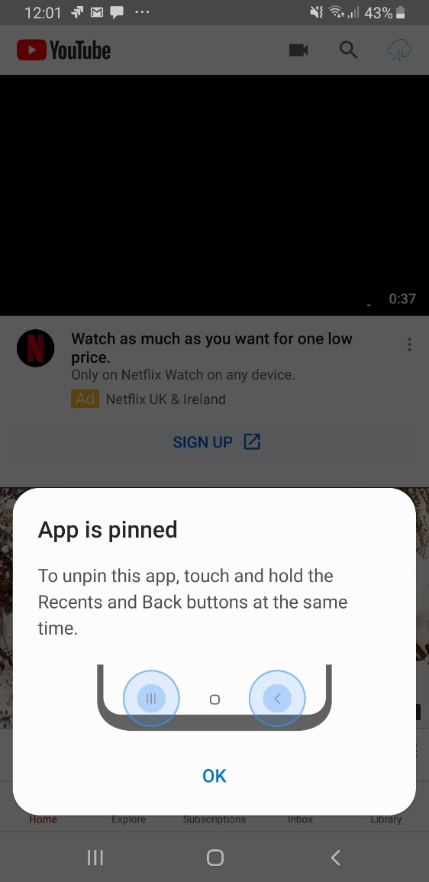
Android - Screen Pinning

Slide 10



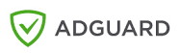

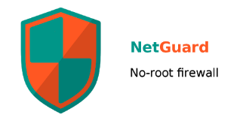
Apps
Google Family Link
Samsung Kid's Home
Adaway (DNS entries, open source)
Using local VPN
Blokada (open source)
AdGuard
Netguard (open source)

Slide 11

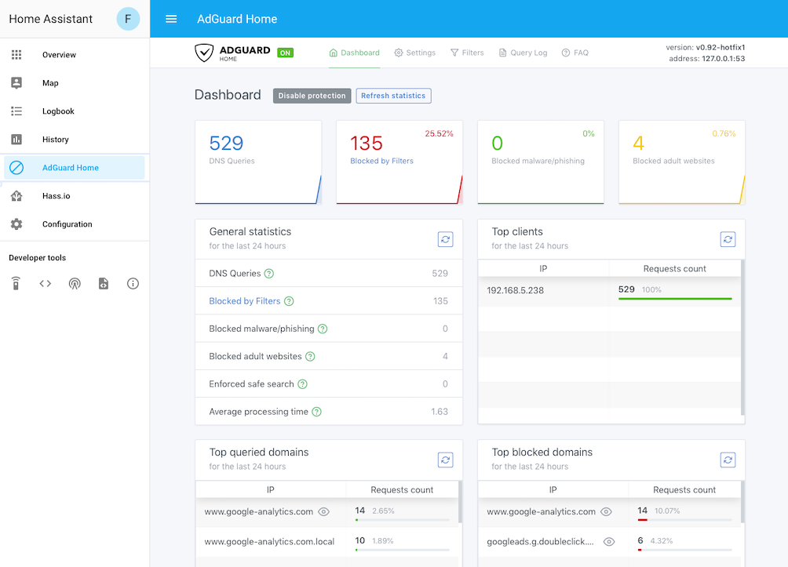
Network-level
DNS
Managed
OpenDNS Family
AdGuard Family
Self-Hosted
Pi-Hole
AdGuard Home
Firewall (require decent hardware)
OPNSense
Sophos XG Home

Slide 12
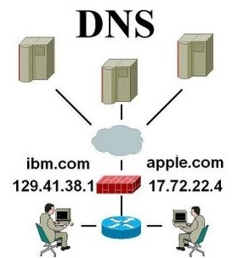
DNS-based 1/3
Blocks device from resolving domain names
Does not know about requestor or context
Can block ads, inappropriate content
Can be setup on device or on the network router
Examples
Pi-Hole
AdGuard Home
OpenDNS FamilyShield
AdGuard Family

Slide 13
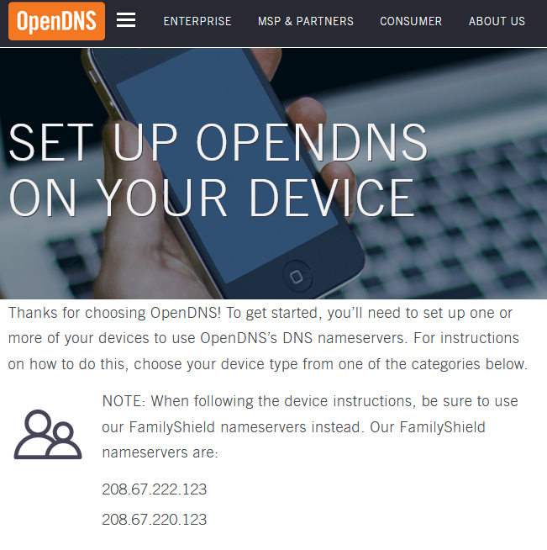
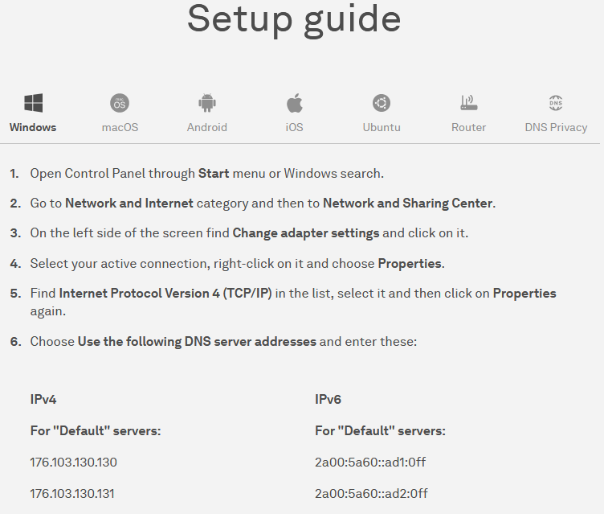
DNS-based 2/3

Slide 14
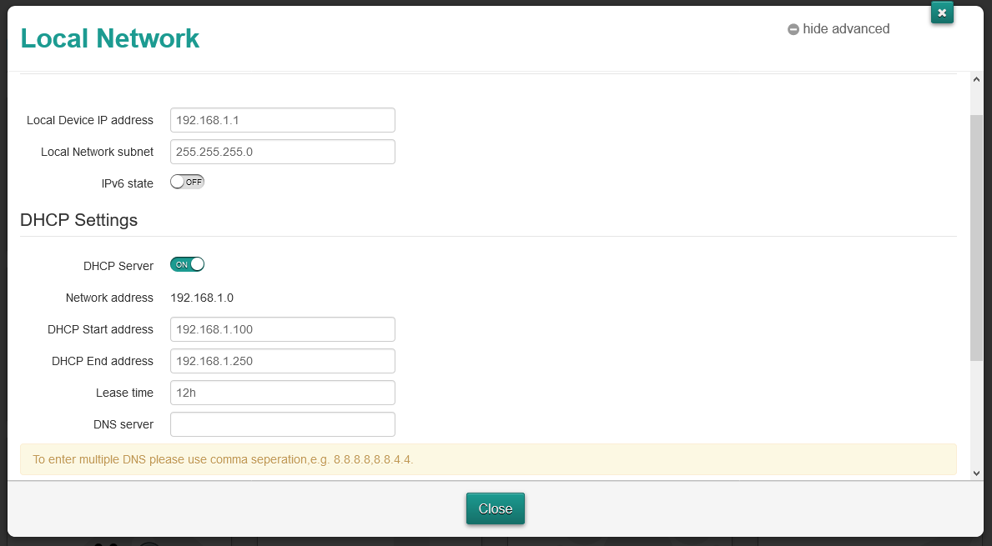
DNS-based 3/3

Slide 15





Content-level
(All of these solutions require dedicated hardware, and as such are probably not as suited for simple, "reasonable" Parental Controls)
OPNSense Firewall
Open source
Can be used to deploy Sensei or e2guardian
AWS deployment
e2guardian
open source, no UI
Probably very powerful, but hard to setup/ configure
Sunny Valley Sensei
Free plan (excluding per-user settings)
Tricky to setup on OpnSense
Requires OpnSense (FreeBSD, not docker-able)
Diladele Web Safety (paid)
Easy to setup
Supports youtube channel filtering
Works well out of the box
24.99 € / year, 7 devices
AWS Trial

Slide 16
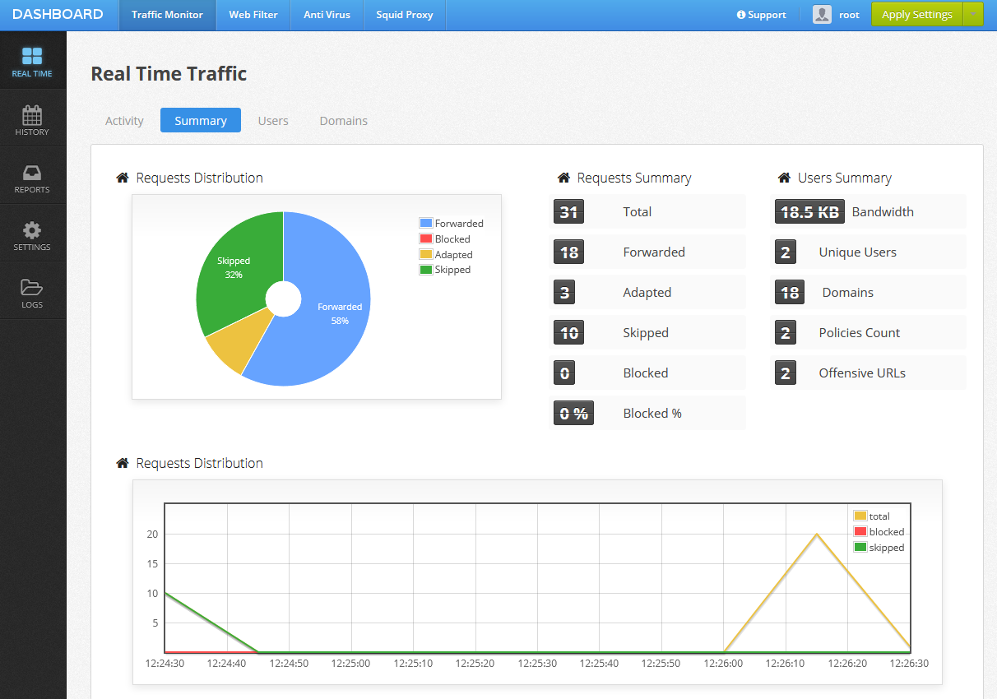
Diladele Web Safety

Slide 17
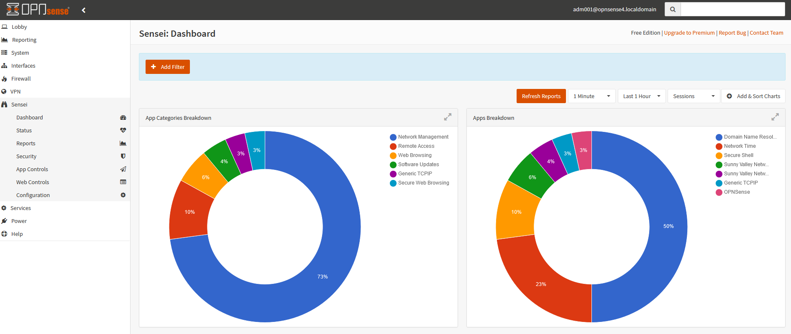
Sensei

Slide 18
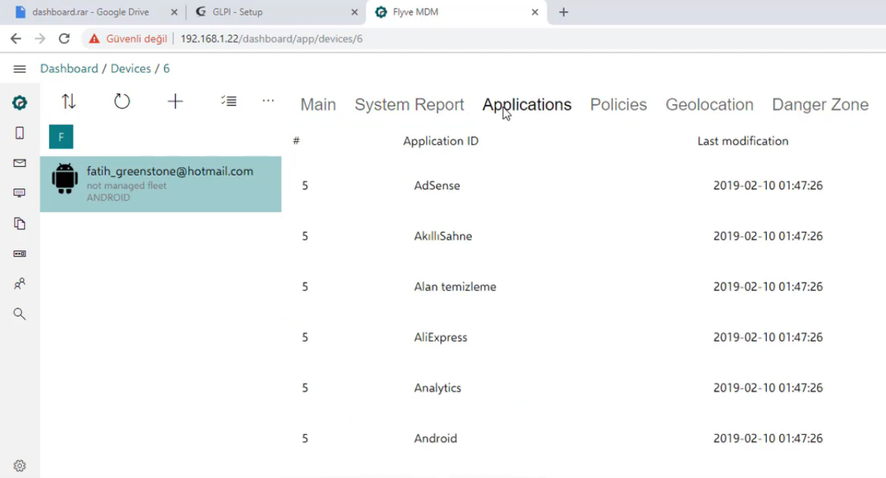
(Open Source) Mobile Device Management
When we have multiple devices and want to deploy CA certs, monitor installed apps, jailbreaking, etc.
Flyve MDM
Headwind MDM

Slide 19
Filtering Challenges
End-to-end encryption (WhatsApp, Telegram, Signal)
Certificate pinning (Chrome, Google, Android)
Anti Ad-block features (RTE Player)

Slide 20
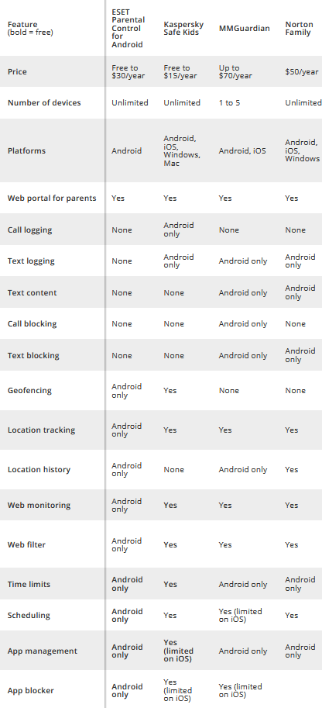
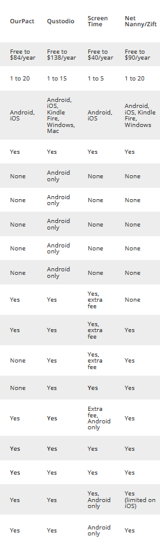
Commercial App Options
Qustodio (market leader? $54/ year for 5 devices)
Kaspersky Safe Kids ($15/ year)
Norton Family Premier ($50/ year; part of Norton 360 Deluxe)
McAfee Safe Family ($45/ year; part of Total Protection)
NetNanny ($55/ year)
Screentime Labs (free version; Premium: EUR80/ year)
OurPact ($24/ year Plus; $84/ year Premium)
Bark (Social Media) ($168/ year)
Bark seems to be a very strong contender for Social Media monitoring.
(Note: annual subscriptions like 360 Deluxe and Total Protection are often sold at very steep discounts)
source: https://www.tomsguide.com/us/best-parental-control-apps,review-2258.html

Slide 21
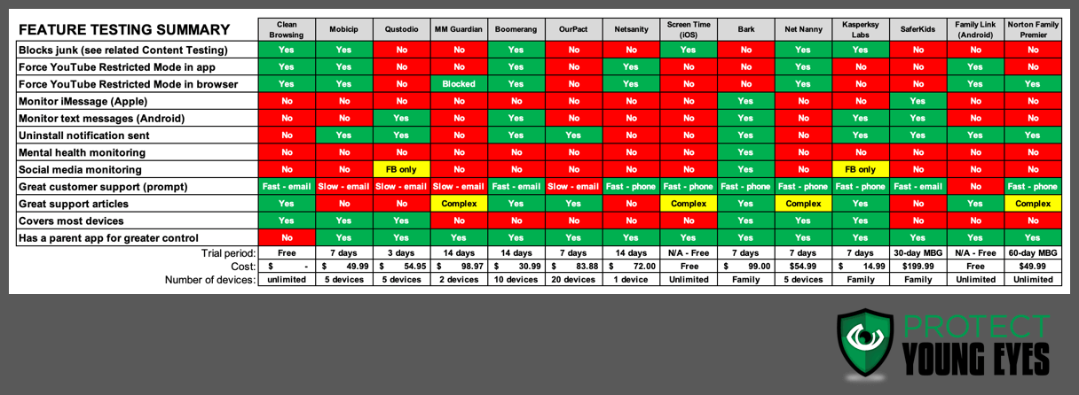
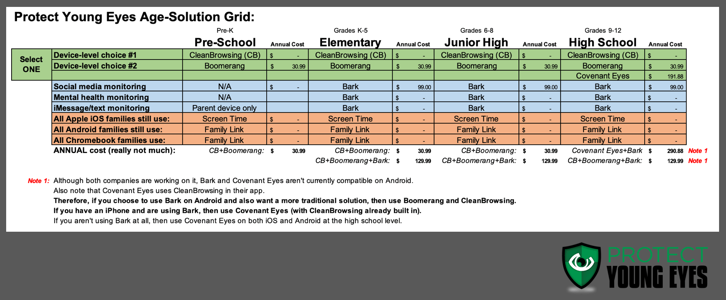
source: https://protectyoungeyes.com/the-best-parental-control-software-for-2020/

Slide 22
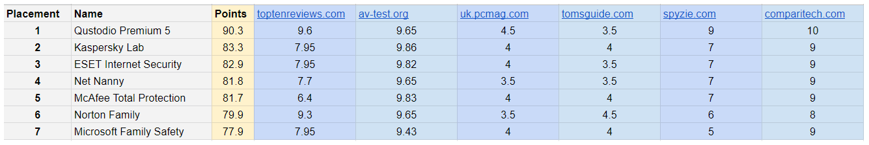
Commercial App Options 3/3
source: https://www.expertido.org/internet-filter-software-meta-study/

Slide 23
TL;DR
Use iOS ScreenTime, Parental Link, Samsung Kids
Use a hosted DNS filter
Use a commercial option (i.e. Kaspersky Safe Kids)
Host your own Pi-Hole or AdGuard Home
Consider Diladele Web Safety
Firewalls are a pain to setup
I will post updates to these slides and findings on: blog.sensatus.io

Slide 24
Other Resources
Microsoft SigCheck to look for dubious installed Root CAs
docker-websafety maybe it's possible to run Diladele on a modern Raspberry Pi?
Self-hosting OpnSense on Azure
AdGuard Home Docker

